Slide 1
Minor Project Medical Chatbot
Diagnosis and Medicines Recommendation
Yogita Bala Singh – 1505626
Gaurav Singh – 1505627
Zeeshan Ali Naqvi -1505632
Siba Prasad Tripathy – 1505638
Sayan Chakraborty -1521039
Project Guide – Prof.B.S.P Mishra

Slide 2
Project’s Importance
Easy to use Diagnosis and Treatment suggestion system
User feeds their symptoms to get likely diagnosis
Future use after expansion
Can be used in rural area after expansion of the project
Along with diagnosis the medicines and treatments are suggested
Can be used in their local tongue

Slide 3


Intended users
After a proper SMS integration Product can be used by people in rural areas without internet facilities
Urban Users
Rural Users
Product can be accessed and used using web interface and modern easy to use GUI
Can be used using internet services
Product can be used by rural users
At places where internet services are not available
Mobile SMS is used to access the product

Slide 4
Implementation
Dataset : Secondary Dataset fetched from Kaggle used for designing symptom-disease-recommender.
Data Processing: After preprocessing 4 datasets was obtained
The list of symptoms along with unique symptom ids (sid) and their symptoms
The second containing diseases along with unique diagnosis ids (did).
The third one containing a list of appropriate medicines or treatments for the specified diagnosis.
A separate dataset denoting the references to the proper diseases from their symptoms through the unique ids

Slide 5
Natural Language Processing
Definition:
Natural-language processing (NLP) is an area of computer science and artificial intelligence concerned with the interactions between computers and human (natural) languages, in particular how to program computers to fruitfully process large amounts of natural language data.
Challenges in natural-language processing frequently involve speech recognition, natural-language understanding, and natural-language generation

Slide 6
NLP (Continued)
Some Keywords:
Stop Words: Stop words a set of words defined according to a proper selected language which are thought to be redundant in the main implementation framework.
Stemming: Stemming is a normalizing method in Natural Language Processing. Many variations of words carry the same meaning, other than when tense is involved. The reason why we stem is to shorten the lookup, and normalize sentences
Lemmatizing: Lemmatizing is another method of normalizing words to produce root words that are meaningful.

Slide 7
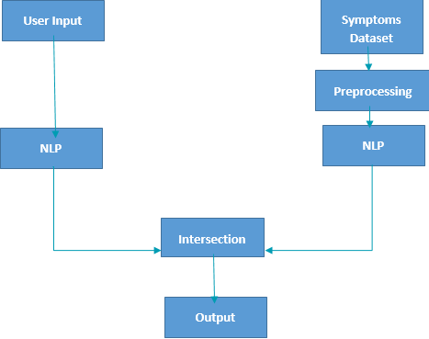
Work Flow

Slide 8
Process Details
The user input string was extracted:
Removed the unnecessary words from the input string.
Porter Stemmer Algorithm was applied to stem the input string and lemmatized to a proper matching format.
The symptoms dataset was modified for proper string matching:
The symptoms dataset was stemmed and lemmatized to have proper results on string matching.
An intersection was performed between the input string and the symptoms dataset to find the most appropriate match.

Slide 9
Process Details
The matching was further refined by inducing a secondary query, where the user was prompted to enter a more appropriate symptom based on the matching symptoms from the data.
Proper diagnosis of the disease and the medicine/treatment was suggested based on the symptoms chosen by the user
The suggestion was based on the weights on the diagnoses, which indicated the number of times a particular diagnosis was made for a corresponding symptom.

Slide 10
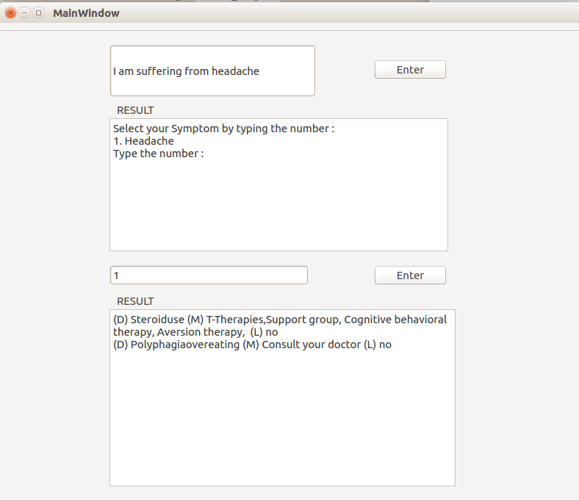
User Interaction
User Interface was Created using with Qt Creator (pyQt4)
The UI contains a line edit, two text edit boxes and two buttons.
The line edit text is used for taking input, Text edit boxes for output results.

Slide 11
Overall Flow
String of symptoms
NLP to filter appropriate strings
Refinement of symptoms
Output of desired diagnosis and medicines

Slide 12
Future Scope
Implementation Improvements:
As a major improvement, the services are thought to be integrated into a generic SMS scheme, mainly for the people of rural areas, since people of rural areas are not aware of modern facilities like the internet or accustomed to complex GUIs or mobile applications.

Slide 13
Future Scope
Major Improvements on Project:
As a major prediction improvement, the project is thought to be implemented using a basic Seq2seq model using a generic encoding decoding scheme with a Recurrent Neural Network.

Slide 14
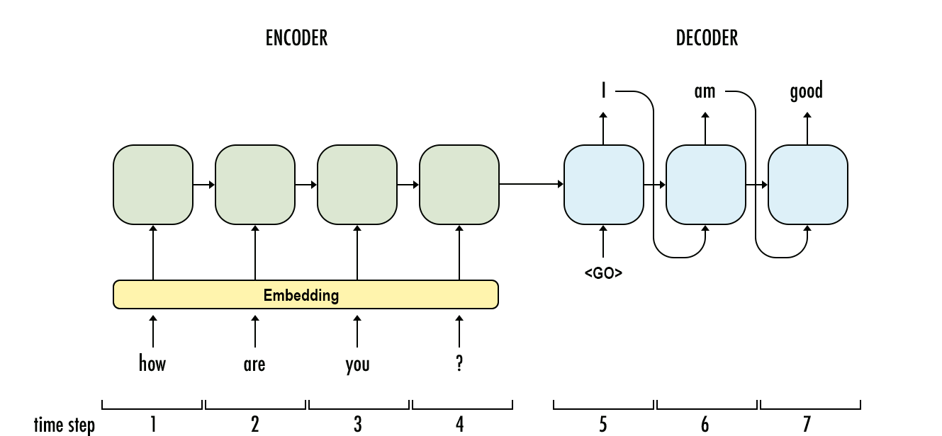
Diagrammatic Representation
RNN Encoding Decoding Architecture:

Slide 15
References
For Natural Language Processing and Data Preprocessing:
www.pythonprogramming.net
https://www.stackoverflow.com
http://www.nltk.org/book/
For Dataset (Secondary):
https://www.kaggle.com/plarmuseau/symptom-disease-recommender/data
For SMS Encryption:
https://security.stackexchange.com/questions/11493/how-hard-is-it-to-intercept-sms-two-factor-authentication
For SRS document:
https://web.cs.dal.ca/~hawkey/3130/srs_template-ieee.doc

